Slide 1

SONG ANALYSIS
Presented by:
Nwachuwku Zinachidi

Slide 2


Agenda
Topics Covered
1
Problem
Statement
2
Dataset Overview
3
Project
Objectives
4
Dashboard
5
Insights

Slide 3
Problem Statement
This internship project aims to conduct a comprehensive analysis of YouTube songs data using Power BI. The dataset contains key attributes such as video ID, channel title, title, description, tags, published date, view count, like count, favorite count, comment count, video duration, video definition, and caption details. The goal is to utilize Power BI to create insightful visualizations and reports that provide a deeper understanding of YouTube songs' performance, popularity, and user engagement. The analysis aims to uncover trends, preferences, and patterns in the data to aid content creators and stakeholders in optimizing their YouTube song content.

Slide 4
Dataset Overview
1. video_id: Unique identifier for each YouTube video.
2. channelTitle: Title of the YouTube channel publishing the song.
3. title: Title of the YouTube song video.
4. description: Description provided for the YouTube song video.
5. tags: Tags associated with the YouTube song video.
6. publishedAt: Date and time when the YouTube song video was published.
7. viewCount: Number of views received by the YouTube song video.
8. likeCount: Number of likes received by the YouTube song video.
9. favoriteCount: Number of times the YouTube song video has been marked as a favorite.
10. commentCount: Number of comments posted on the YouTube song video.
11. duration: Duration of the YouTube song video.
12. definition: Video definition or quality (e.g., HD, SD).
13. caption: Availability of captions for the YouTube song video.

Slide 5

Project Objectives

Slide 6
1. Data Cleaning and Preparation:
- Clean and preprocess the dataset, handling missing values or outliers.
- Convert relevant columns to appropriate data types.
2. Exploratory Data Analysis (EDA):
- Explore patterns and distributions in view counts, like counts, and comments.
- Identify trends in the popularity and engagement of YouTube song videos.
3. Content and Channel Analysis:
- Analyze the distribution of videos across different channels.
- Identify popular tags and their correlation with view counts.
4. Temporal Trends:
- Explore how YouTube song video metrics vary over time.
- Identify peak publishing times and their impact on engagement.
5. User Engagement Insights:
- Investigate relationships between likes, comments, and views.
- Identify factors influencing user engagement with YouTube song videos.

Slide 7
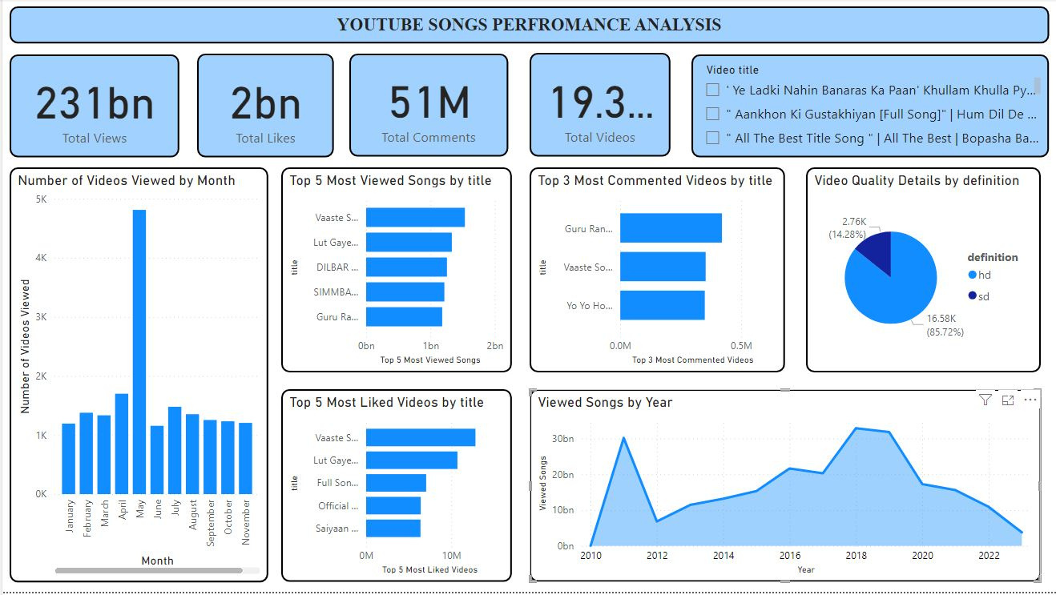
Dashboard

Slide 8
>
Total Views
Insights
The dashboard shows a total of 231 billion views.
>
Top 5 Most Viewed Songs
The Top 5 most viewed songs were “Vaaste Song”, “Lut Gaye”, “DILBAR Lyrical”, “SIMMBA” and “Guru Randhwa”
>
Top 5 Most Liked Songs
The Top 5 most liked songs were “Vaaste Song”, “Lut Gaye”, “Full Song”, “Official Video” and “Saiyaan Ji”
>
Top 3 Most Commented Videos
The Top 3 most commented videos were “Guru Randhawa”, “Vaaste Song’ and “Yo Yo Honey Singh
>
Video Quality
85.75% of the song videos were in HD quality and 14.28% of the song videos were in SD quality
>
Engagement Metrics
There were a total of 2 billion likes and 51 million comments.

Slide 9


THANK YOU

